Slide 1
Machine Learning Learnings
From perceptron to object detection
Romas Zubavicius

Slide 2
Table of Contents
Perceptron
Biological representation
Artificial representation
Feed-forward
Classification
Regression
Back propagation
Non-linearity
Deep neural networks
Image classification
Archictectures
Classification + localization?
First part - basics
Second part – more abstract concepts

Slide 3
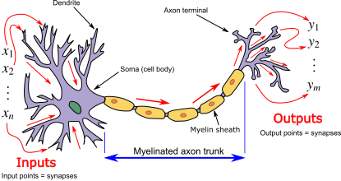
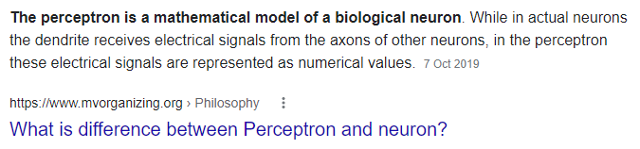
Perceptron? Neuron?
(Insert mandatory biological neuron explanation)

Slide 4
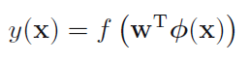
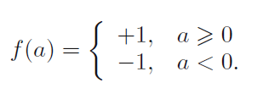
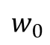

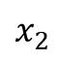
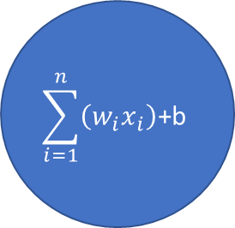
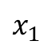
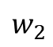
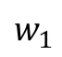
Linear perceptron
bias
$$w_{0}$$
$$\sum_{i=1}^{n}{\left(w_{i}x_{i}\right)\text{+}\text{b}}$$
$$w_{1}$$
$$x_{1}$$
classification
$$w_{2}$$
$$x_{2}$$
$$w_{0}+w_{1}x_{1}+w_{2}x_{2}=0$$

Slide 5
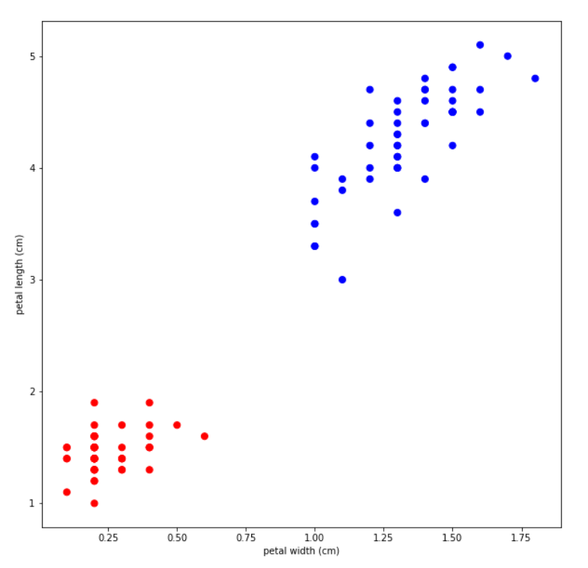
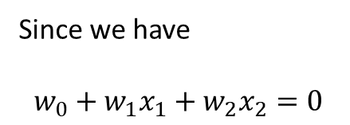
Line which splits the two classes
Since we have
$$w_{0}+w_{1}x_{1}+w_{2}x_{2}=0$$

Slide 6
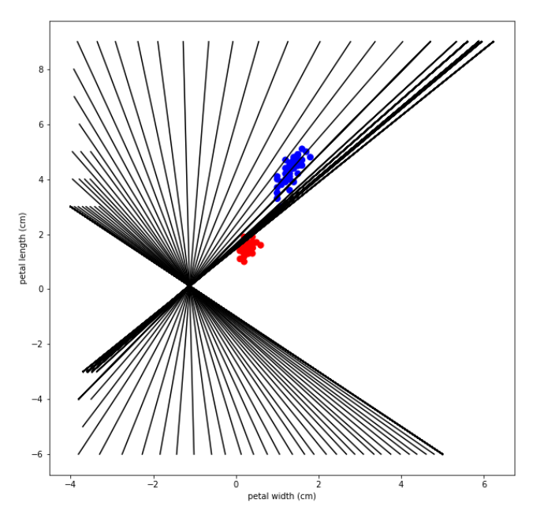
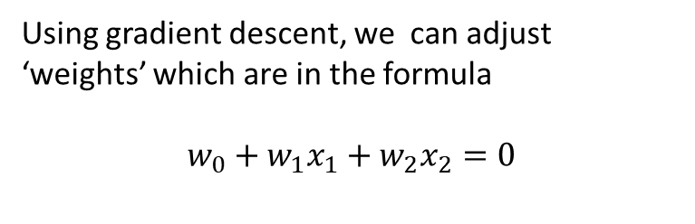
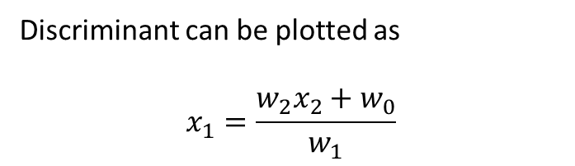
Linear discriminants
Using gradient descent, we can adjust ‘weights’ which are in the formula
$$w_{0}+w_{1}x_{1}+w_{2}x_{2}=0$$
Discriminant can be plotted as
$$x_{1}=\frac{w_{2}x_{2}+w_{0}}{w_{1}}$$

Slide 7
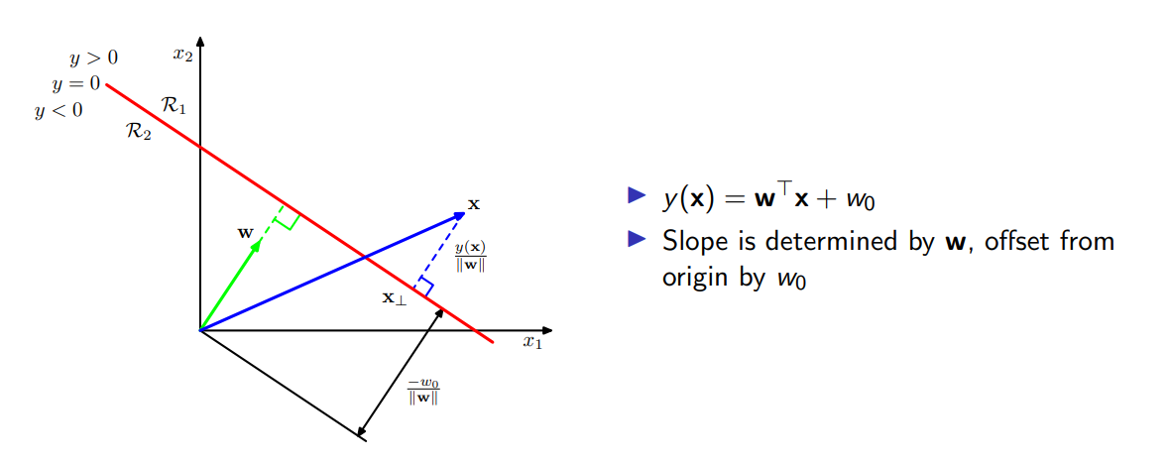

Slide 8
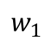
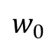
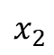
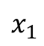
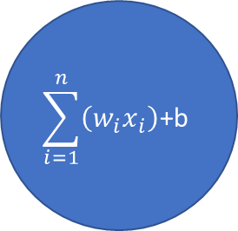
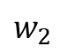
Regression
bias
$$w_{0}$$
$$\sum_{i=1}^{n}{\left(w_{i}x_{i}\right)\text{+}\text{b}}$$
$$w_{1}$$
$$w_{0}+w_{1}x_{1}+w_{2}x_{2}=target$$
$$x_{1}$$
$$w_{2}$$
$$x_{2}$$

Slide 9
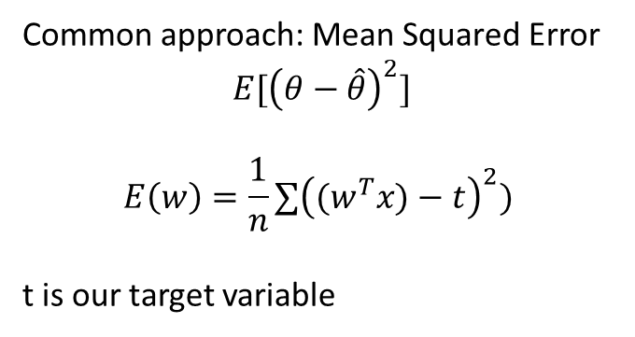
$$w_{0}+w_{1}x_{1}=target$$
Line which would fit best?
We can implement ‘cost function’
Thing that we are trying to minimize
Common approach: Mean Squared Error
$$E[{\left(θ−\hat{θ}\right)}^{2}]$$
$$E\left(w\right)=\frac{1}{n}∑{\left({(w}^{T}x)−t\right)}^{2})$$
t is our target variable

Slide 10
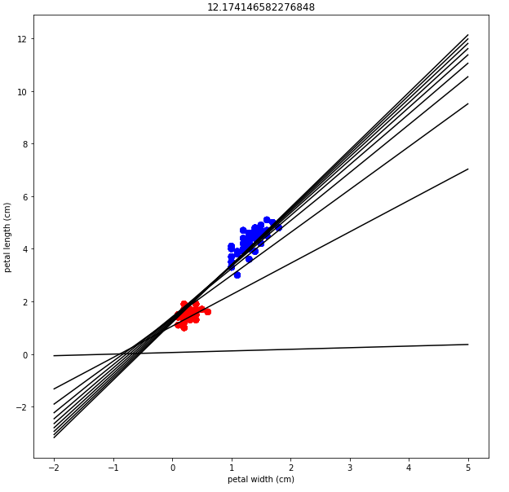
300 iterations (weight updates) with learning rate 0.01
But how does it work??!

Slide 11

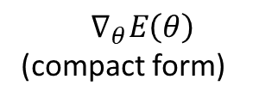
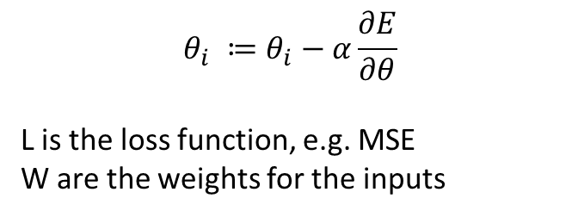
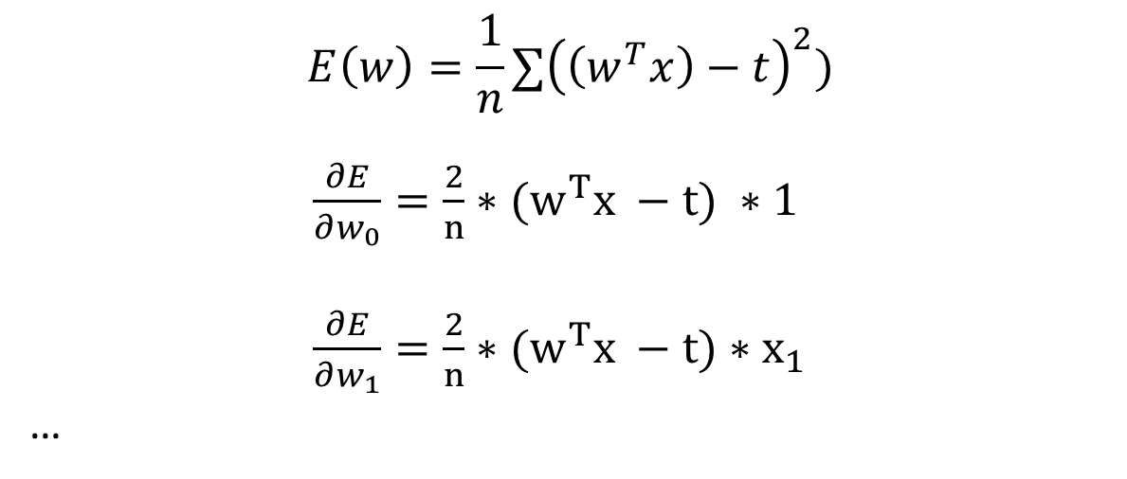
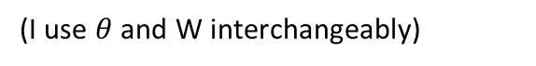
Gradient descent
$$θ_{i} ≔θ_{i}−α\frac{∂E}{∂θ}$$
L is the loss function, e.g. MSE
W are the weights for the inputs
$$∇_{θ}E\left(θ\right)$$
(compact form)
(I use $θ$ and W interchangeably)
$$E\left(w\right)=\frac{1}{n}∑{\left(\left(w^{T}x\right)−t\right)}^{2})$$
$\frac{∂E}{∂w_{0}}=\frac{2}{n}∗{(w}^{T}x −t) ∗1$
$\frac{∂E}{∂w_{1}}=\frac{2}{n}∗{(w}^{T}x −t)∗x_{1}$
…
$$w_{0}+w_{1}x_{1}+w_{2}x_{2}=target$$
That’s why its better to normalize data

Slide 12
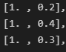
def mse_gd(x, theta, t, alpha):
n = len(x)
theta -= alpha * (2/n * (theta.dot(x.T) - t) * x)
return theta
def gradient_descent(x, theta, alpha, err):
theta += alpha * (err) * x # err <- (expected – predicted)
return theta
(!) Data in the form of [1., data column] for x (1 is for the bias weight)
(!) There are multiple ways to initialize theta’s (weights)
Simply all weights to 0
Random initialization
(advanced/used for NN) Xavier initialization (also called Glorot)
(advanced/used for NN) He initialization

Slide 13
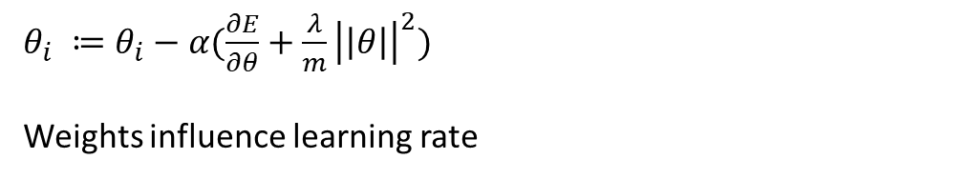
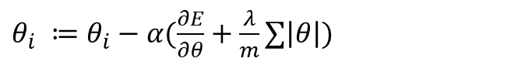
Gradient descent (more advanced)
A simple normal gradient descent is too simple..
L1 reguralization –
L2 reguralization -
Also.. To name a few optimizers…
RMSProp
Adam Optimizer
Sgd + momentum optimizer
$θ_{i} ≔θ_{i}−α(\frac{∂E}{∂θ}+\frac{λ}{m}∑\left|θ\right|)$
penalty
$θ_{i} ≔θ_{i}−α(\frac{∂E}{∂θ}+\frac{λ}{m}{\left|\left|θ\right|\right|}^{2})$
Weights influence learning rate

Slide 14
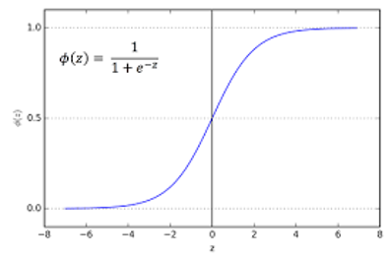
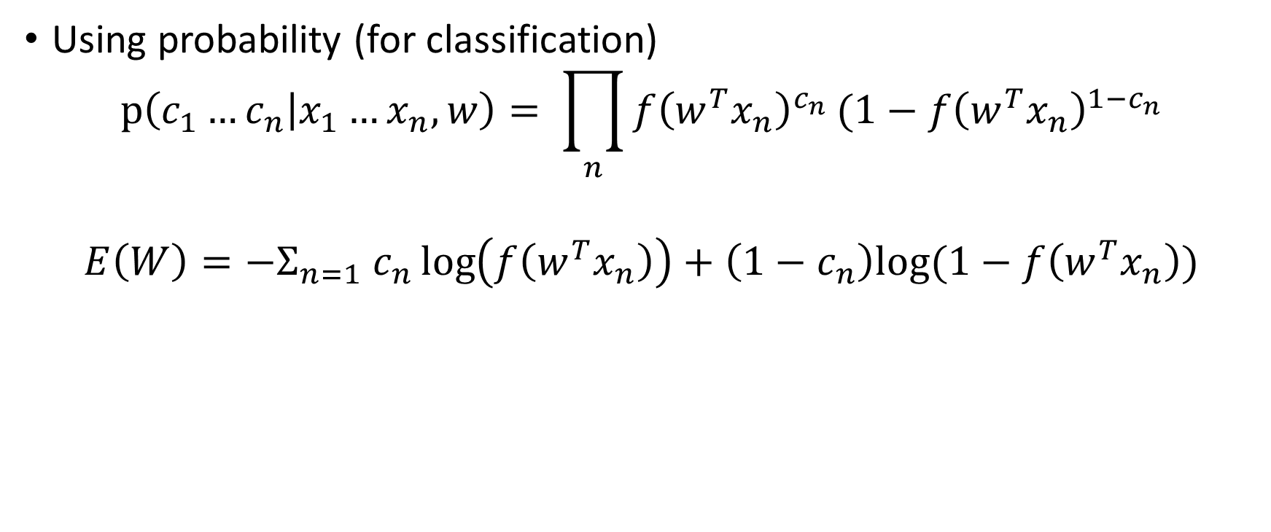
Cost functions (also called loss function or error function)
Using probability (for classification)
$$p\left(c_{1}…c_{n} | x_{1}…x_{n},w\right)= \prod_{n}{f{\left(w^{T}x_{n}\right)}^{c_{n}}}(1−f{\left(w^{T}x_{n}\right)}^{1−c_{n}}$$
$${E\left(W\right)=−Σ}_{n=1} c_{n}\log\left(f\left(w^{T}x_{n}\right)\right)+\left(1−c_{n}\right)log⁡(1−f\left(w^{T}x_{n}\right))$$
Sigmoid

Slide 15
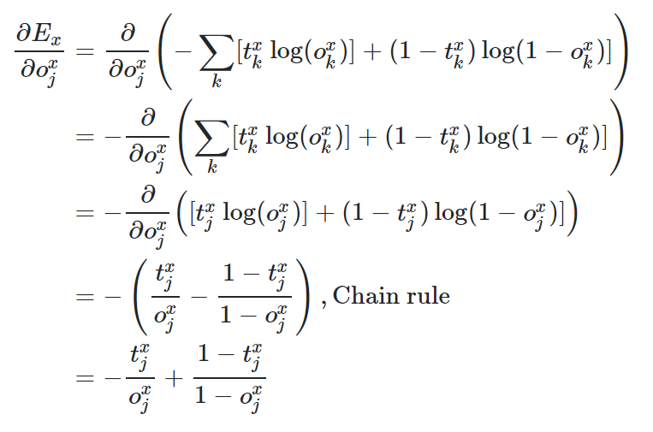

Slide 16
Things to look at
Simple regression example using probably MSE?
Representation learning (?)
Dropout (?) <- for Neural Networks
Weight sharing(?) <- for Neural Networks

Slide 17
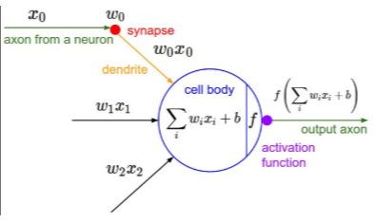
Introducing non-linearity
ReLU/Sigmoid/TanH/ etc…
bias
Activation
function

Slide 18
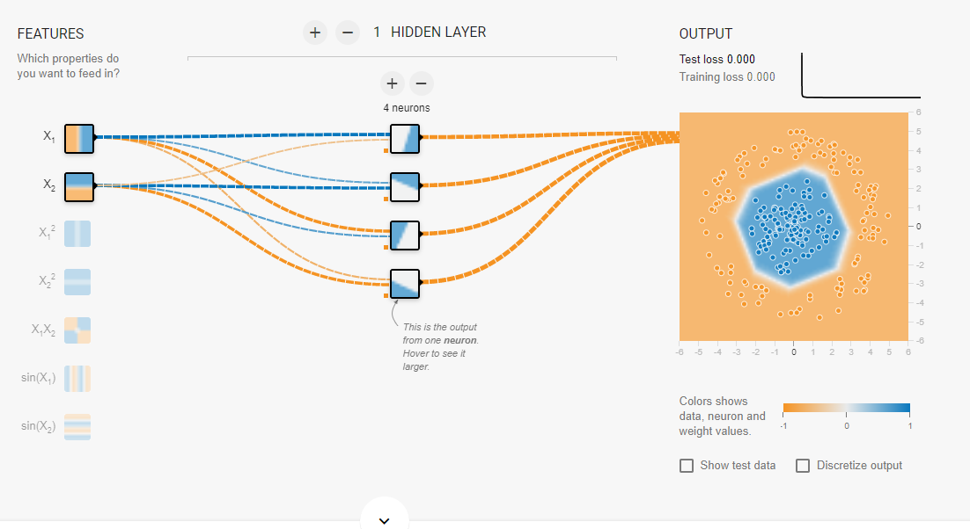
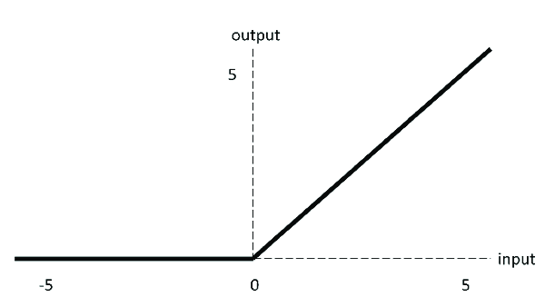
Multilayer perceptron
IN
F(x)
ReLU
https://playground.tensorflow.org

Slide 19
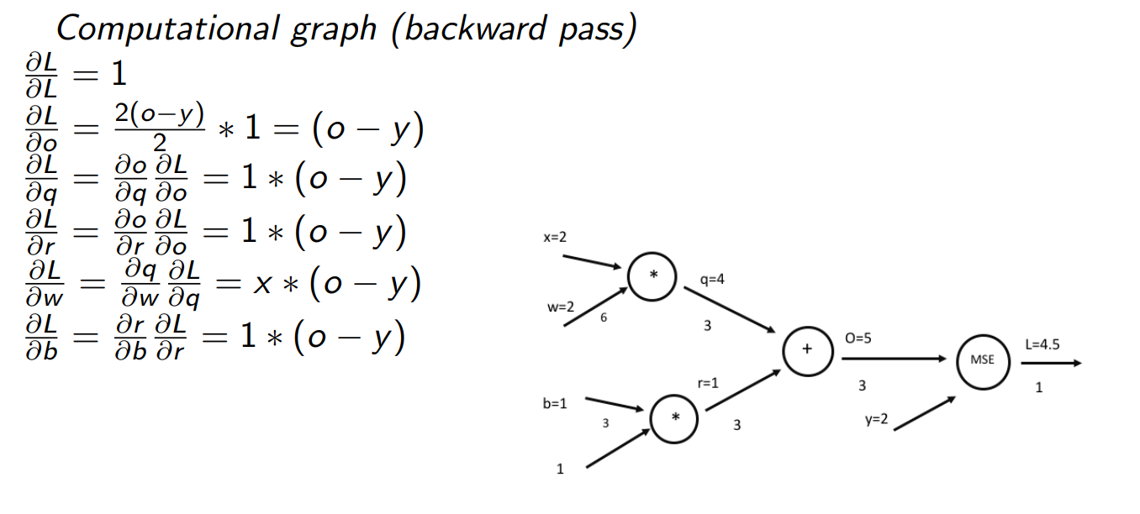
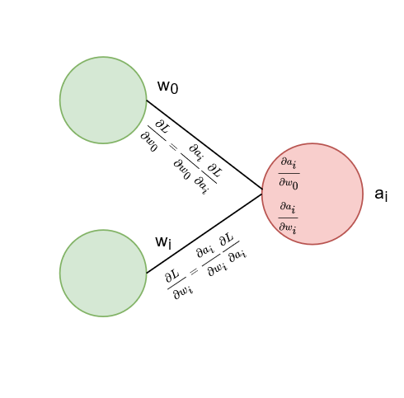

Slide 20

(Deep) Neural Networks
https://stats.stackexchange.com/questions/315402/multi-layer-perceptron-vs-deep-neural-network

Slide 21
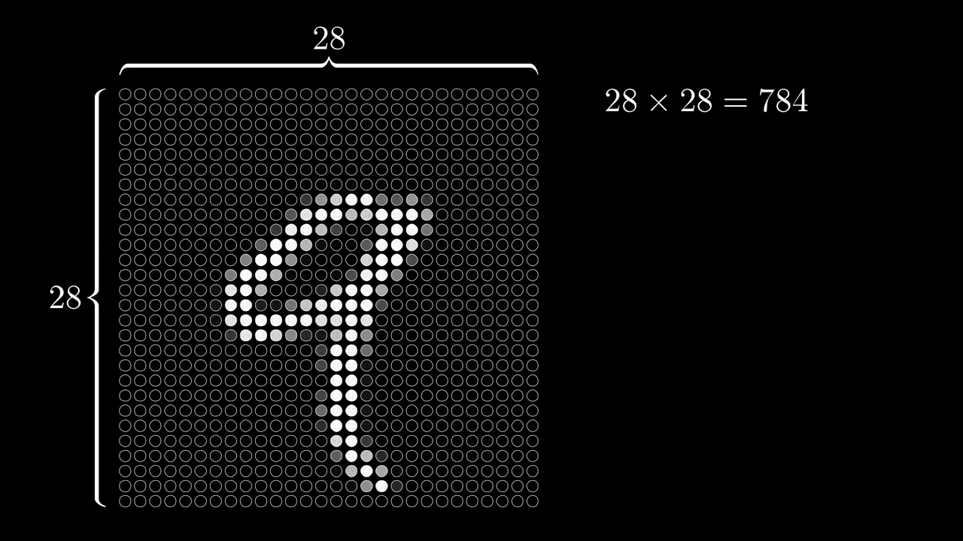
Image classification

Slide 22
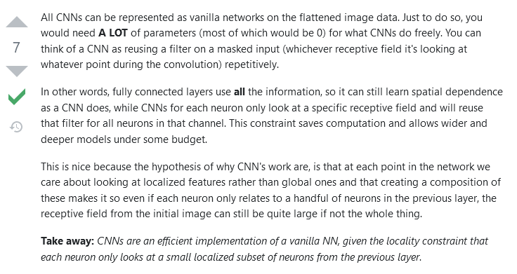
https://ai.stackexchange.com/questions/13266/can-a-vanilla-neural-network-theoretically-achieve-the-same-performance-as-cnn/13267

Slide 23
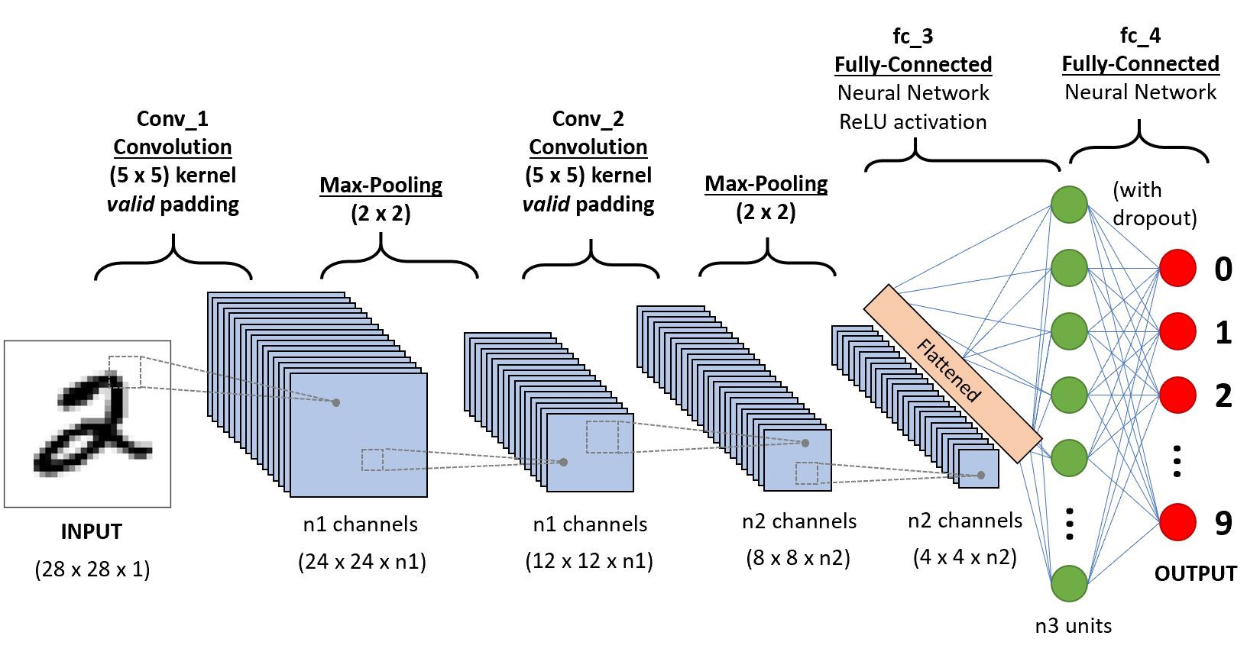
Convolutional Neural Network
Source: https://towardsdatascience.com/a-comprehensive-guide-to-convolutional-neural-networks-the-eli5-way-3bd2b1164a53

Slide 24

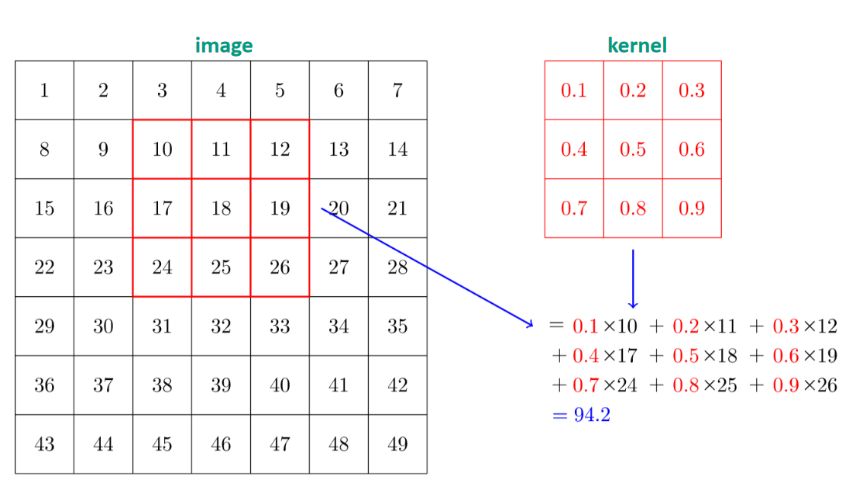
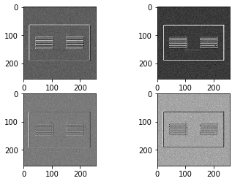
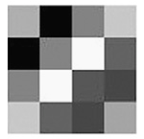
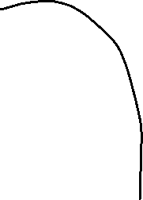
Convolutions
Maxpooling
Feature map
At the last layer of the architecture, it might look something like this…

Slide 25
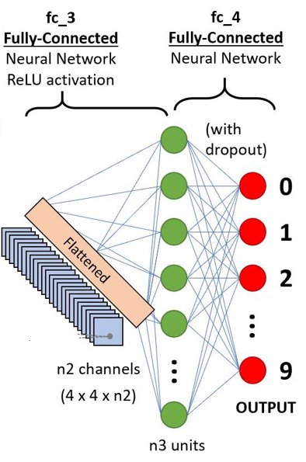
Classifier classes
0.7
0.05
0.02
0.2

Slide 26
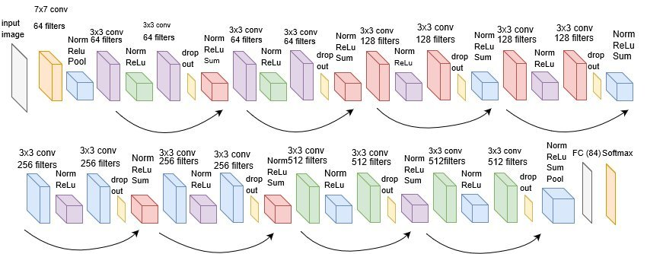
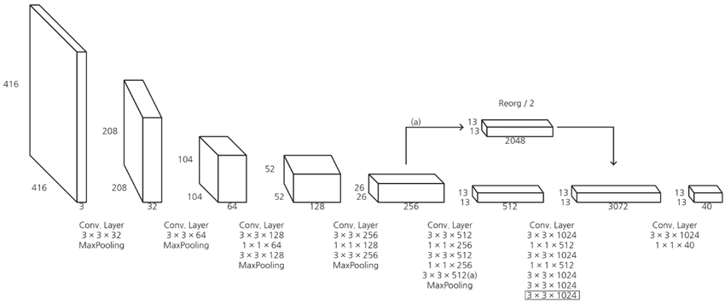
Architectures
Resnet
YOLO

Slide 27

VGG16

Slide 28
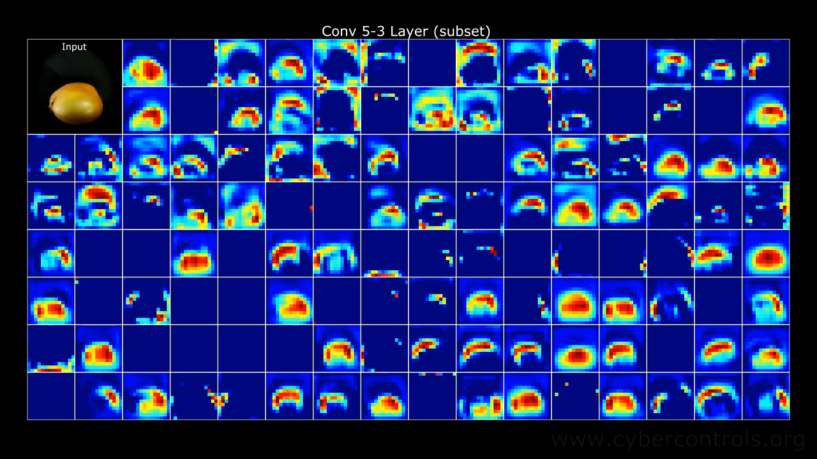
Output of different CNN layers

Slide 29

These architectures are usually benchmarked with COCO or MNIST datasets
https://cocodataset.org/#home
https://en.wikipedia.org/wiki/MNIST_database

Slide 30


Object detection
https://machinelearningmastery.com/object-recognition-with-deep-learning/

Slide 31


Slide 32

https://www.youtube.com/watch?v=GSwYGkTfOKk

Slide 33

https://www.youtube.com/watch?v=GSwYGkTfOKk

Slide 34


Slide 35

EXTRA

Slide 36

EXTRA

